Slide 1

For all New Users!
10%* Off

Slide 2
Diwali Offer
20%* OFF
VALID ONLY TILL NOV, 2021

Slide 3
Fancy Items
10%* OFF

Slide 4
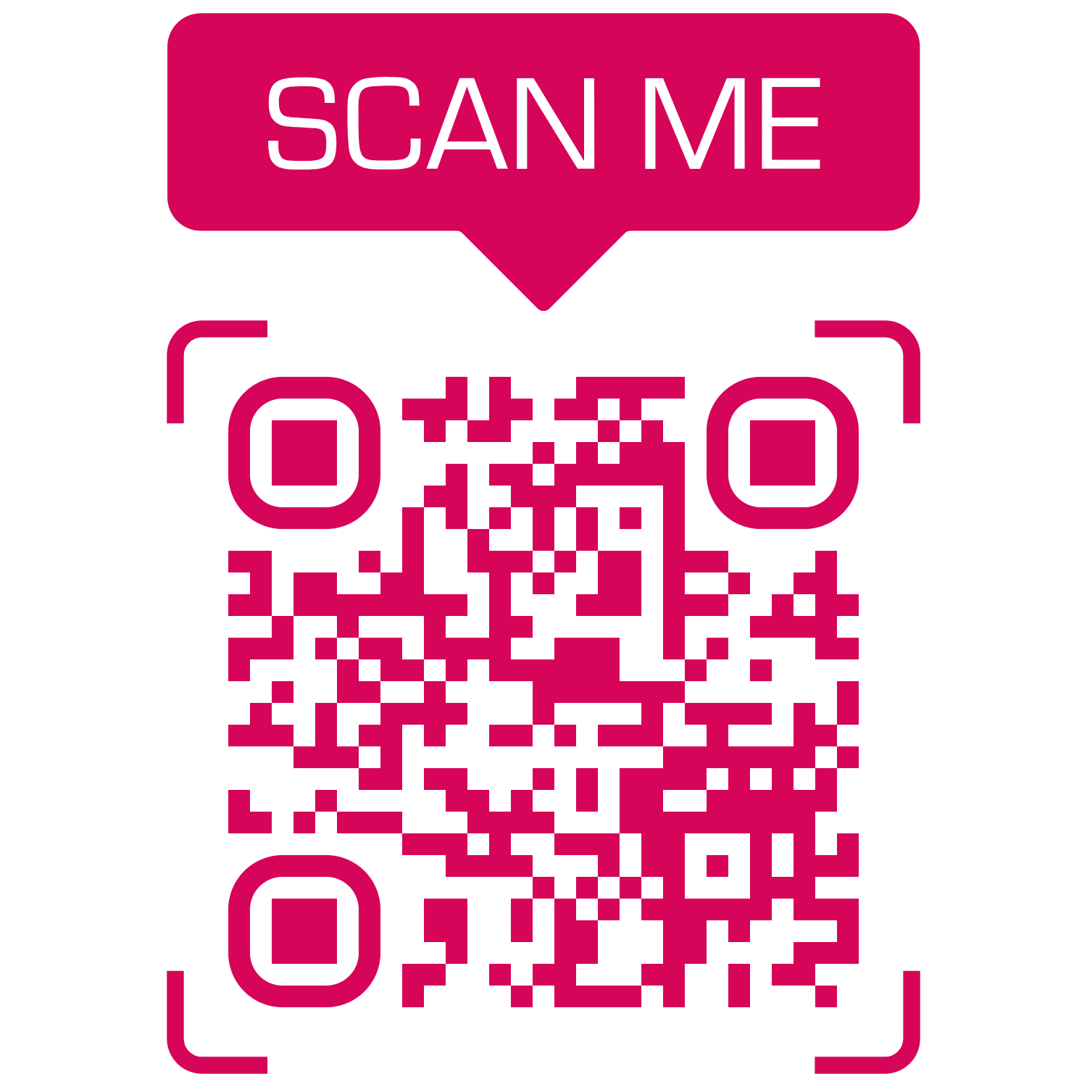

Offer!
Save your time!
Don’t wait in queue
Download
Fresh Look
beauty parlor android app from Google Play store and book ONLINE appointment to
GET
10% OFF
_{Fresh Look}
_{Beauty Parlor}
_{No 39/A, New Street,}
_{Arakkonam - Ocheri Rd,}
_{Nagavedu, Arakkonam}
₊₉₁ ₍₈₂₂₎₋₀₀₆₋₁₀₀₁
₊₉₁ ₍₈₀₉₎₋₈₈₈₋₉₄₉₄
*Ladies & Kids only

